Slide 1

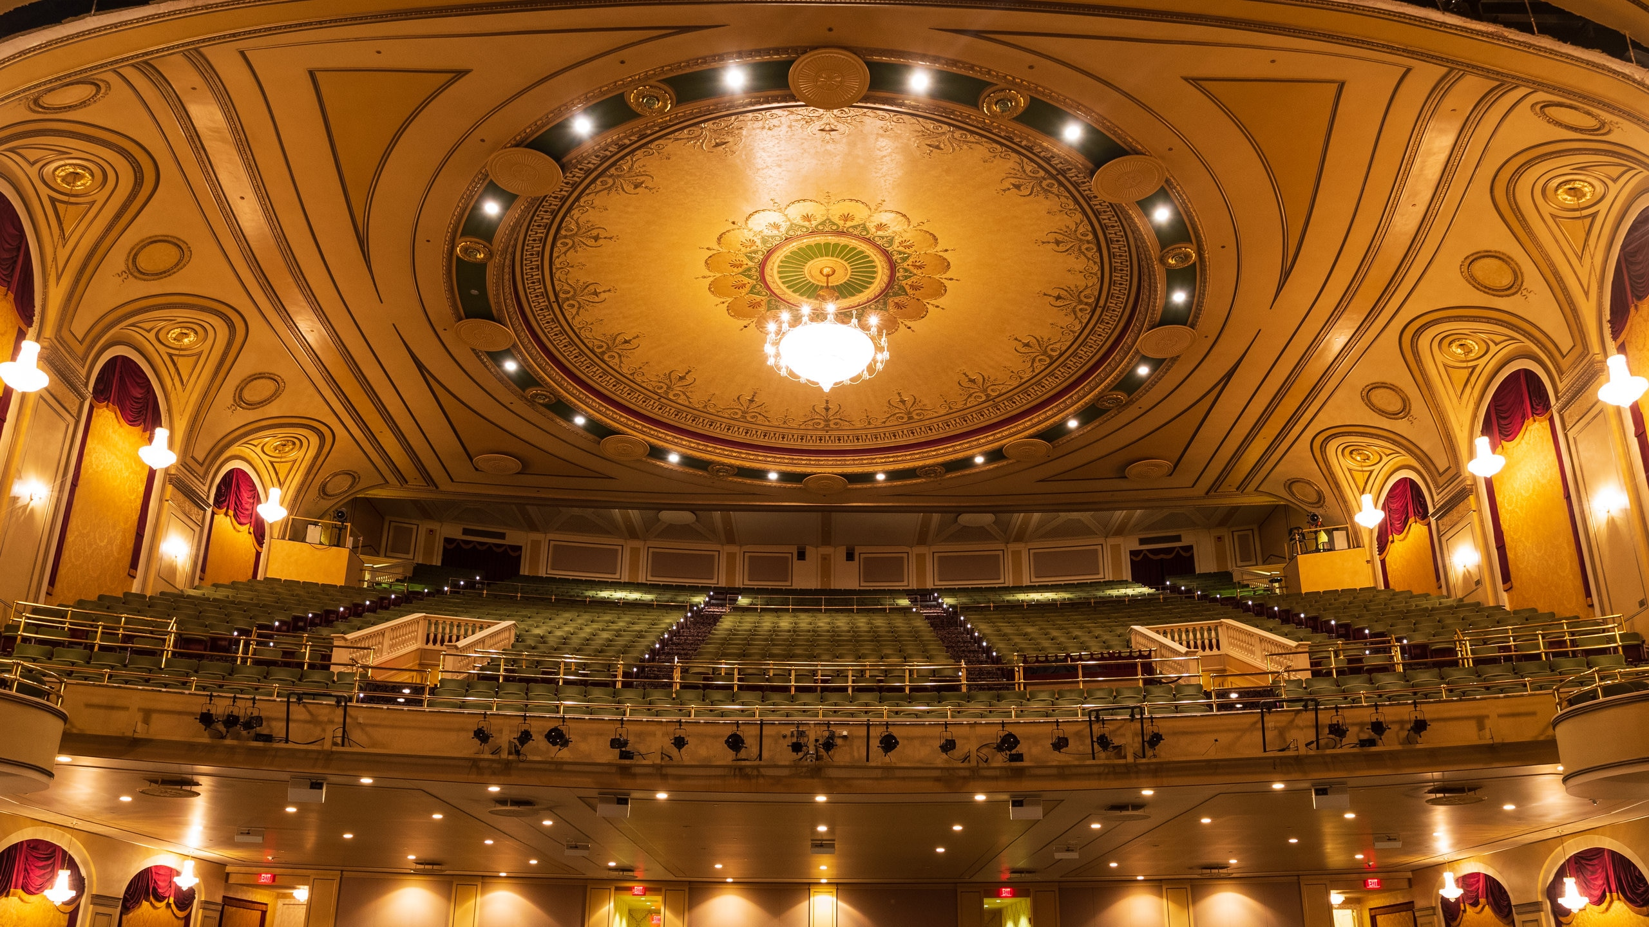


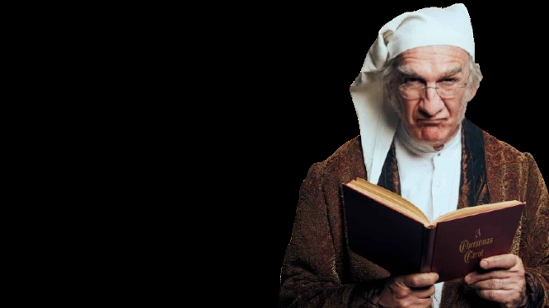

A Christmas Carol by Hanover Theater
Boosting Engagement and Attendance at the Hanover Theatre

Slide 2
Boosting Engagement and Attendance at the Hanover Theatre for A Christmas Carol
Insights and Recommendations for the Hanover Theatre’s Marketing Strategy
By:- Soumyabrata Ghosh
Hanover Theater

Slide 3
Table of Contents
Executive Summary
Introduction
Current Challenges
Data Insights
Strategic Recommendations
Improving Accessibility and Affordability
Flexible Programming and Scheduling
Strengthening Campus and Digital Engagement
Implementation Plan
Expected Outcomes
Conclusion
Appendices

Slide 4
Executive Summary
Overview of Challenges:
High ticket prices
Scheduling conflicts
Accessibility issues
Cultural disconnects
Key Strategies:
Student-friendly pricing
Improved transportation
Flexible programming
Digital and campus engagement
Goal: Expand the audience base and foster community ties.

Slide 5
Introduction
About the Hanover Theatre:
Premier cultural landmark in Worcester
Known for productions like A Christmas Carol
Target Audience:
University students and young professionals
Challenges:
Barriers preventing engagement and attendance
Objective:
Enhance accessibility, affordability, and engagement.

Slide 6
Current Challenges
Affordability:
Ticket prices ($39–$69) are too high for students.
Scheduling Conflicts:
Performances overlap with exams and holidays.
Accessibility:
Limited transportation options in the evenings.
Cultural Disconnect:
International students lack familiarity with some productions.
Awareness Gap:
Awareness does not translate to attendance.

Slide 7
Data Insights
Demographics:
Majority from Clark University and WPI
35% are international students
Attendance Behavior:
70-80% are aware of the Hanover Theatre only 10% been there
Financial Constraints:
Over 90% prefer tickets under $25
50-55% interested in bundled offers
Marketing Preferences:
Instagram and TikTok are favored platforms
Notifications preferred 2–3 weeks in advance
Accessibility Issues:
Transportation is a significant barrier.

Slide 8
Strategic Recommendations Overview
Improving Accessibility and Affordability
Flexible Programming and Scheduling
Strengthening Campus and Digital Engagement

Slide 9
Improving Accessibility and Affordability
Student-Friendly Pricing:
Flat-rate student tickets ($15–$20)
Group discounts for 5+ students (10% off)
Bundled Packages:
Ticket + dining/transportation bundles (e.g., $30 for a ticket and meal)
Subscription Services:
Semester pass ($30–$40) for multiple shows
Transportation Solutions:
Free/subsidized shuttles
Ride-sharing discounts (10–20%)
Align showtimes with public transit

Slide 10

Flexible Programming and Scheduling
Early Semester Performances:
Start A Christmas Carol in late November/early December
Convenient Showtimes:
Early evening shows (6:00 PM)
Weekend matinees
Condensed Performances:
Shortened versions for time-constrained students

Slide 11
Strengthening Campus and Digital Engagement
Campus Outreach:
1. “Student Nights” with discounts and Q&A sessions
2. On-campus promotional booths and events
3. Recruit student ambassadors

Slide 12
Strengthening Campus and Digital Engagement
Digital Marketing:
1. Focus on Instagram and TikTok
2. Interactive content (behind-the-scenes, contests)
3. Partner with influencers

Slide 13
Strengthening Campus and Digital Engagement
Time-Sensitive Promotions:
1. Early-bird discounts
2. Flash sales to create urgency

Slide 14
Implementation Plan Overview
Phase | Timeline | Key Initiatives
Short-Term | 3–6 Months | Student discounts, ride-sharing, shuttle planning, student nights
Mid-Term | 6–12 Months | Bundled packages, semester pass, campus events, influencer campaigns
Long-Term | 12–18 Months | Expand shuttles, subscription services, partnerships, cultural programs

Slide 15
Implementation Plan: Consolidated Phased Approach
Phase | Timeline | Initiatives
Short-Term | 3–6 Months | - Launch discounted ticket pricing for students and pilot group booking discounts.
 |  | - Establish ride-sharing partnerships and offer promotional codes for select performances.
 |  | - Begin planning shuttle routes in collaboration with local universities.
 |  | - Introduce early evening shows and weekend matinees.
 |  | - Partner with a few key international student associations to co-create one or two themed events.
 |  | - Launch “Student Nights” for select performances.
 |  | - Begin recruiting student ambassadors from key universities.
 |  | - Roll out a social media campaign featuring behind-the-scenes content and time-sensitive promotions.

Slide 16
Mid-Term | 6–12 Months | - Roll out bundled “Night Out” packages and promote them on campuses.
 |  | - Align showtimes with public transit schedules and introduce performance guides with transit information.
 |  | - Implement a pilot semester pass program for students.
 |  | - Launch pilot productions featuring global cultural themes.
 |  | - Create multilingual guides and subtitling for select performances.
 |  | - Begin offering pre-show activities tied to major productions.
 |  | - Host promotional events on multiple campuses.
 |  | - Develop partnerships with local influencers and student organizations.
 |  | - Introduce interactive campaigns on Instagram and TikTok.

Slide 17
Long-Term | 12–18 Months | - Expand shuttle services to cover more campuses and events.
 |  | - Evaluate the success of subscription services and consider adding more benefits, such as loyalty rewards.
 |  | - Strengthen partnerships with universities to sustain and enhance engagement.
 |  | - Expand culturally inclusive programming to include multiple events per season.
 |  | - Establish permanent collaborations with university student organizations.
 |  | - Develop a library of digital educational resources for ongoing engagement.
 |  | - Expand the student ambassador program to include all local universities.
 |  | - Evaluate the success of digital campaigns and refine strategies based on analytics and feedback.
 |  | - Continue building relationships with campus communities through collaborative events and consistent outreach.

Slide 18
Expected Outcomes
Increased Attendance: Affordable pricing and transportation options
Enhanced Engagement: Interactive events and digital campaigns
Stronger Community Connections: University partnerships and outreach
Cultural Inclusivity: Diverse programming and multilingual materials
Long-Term Loyalty: Sustainable relationships with student audiences

Slide 19

Conclusion
Goal: Transform the Hanover Theatre into an accessible, inclusive, and dynamic cultural hub for students.
Key Actions:
Affordable pricing models
Improved transportation
Flexible programming
Robust campus and digital engagement
Result: A stronger, more diverse, and engaged audience base.

Slide 20

Thank you
Contact: 508-353-8921
soghosh@clarku.edu

